Slide 1
Motor Vehicle Insurance Dataset
PROJECT - EDA & SQL

Slide 2

Dataset Introduction & Objective
105,555 rows,
30 column
Covers non-life motor insurance contracts (2015 → 2018)
Each row = one policy transaction
Objective → analyze patterns in customer behavior, premium distribution, claims, and retentionLibraries used: pandas, numpy, matplotlib

Slide 3
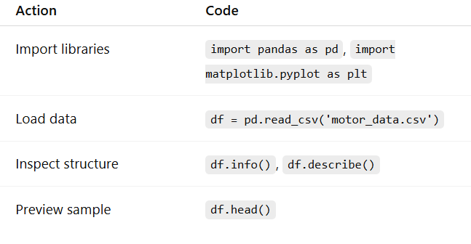
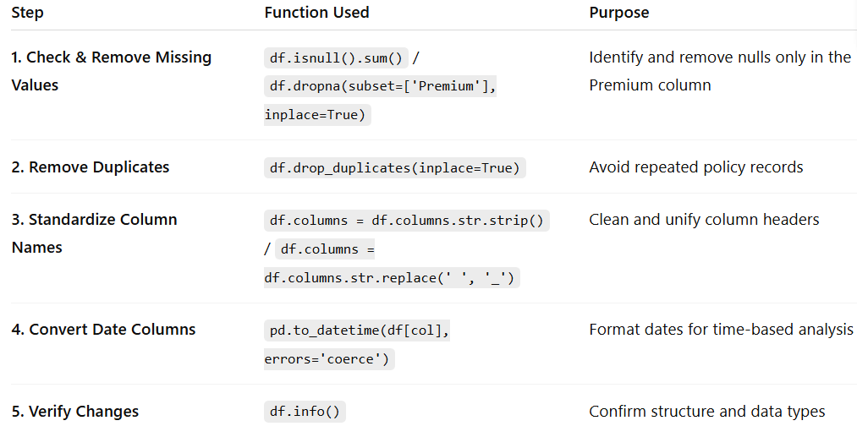
Data Loading Inspection & CLEANING PROCESS

Slide 4
Univariate EDA
Numerical
Premiums
Cost of claims
Seniority
lapse
Categorical
Distribution channels
Policies in force
Area
Fuel type

Slide 5
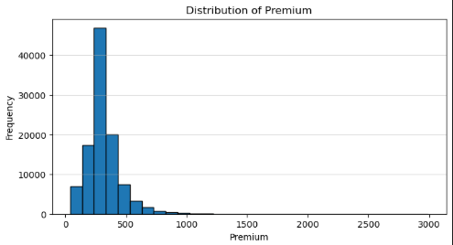
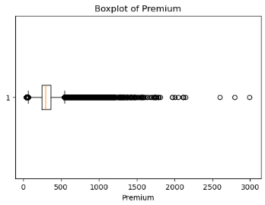
Numerical
Premium (€): Distribution & Outliers
Right-skewed distribution Typical retail portfolio shape High-value outliers = key segment for profit

Slide 6
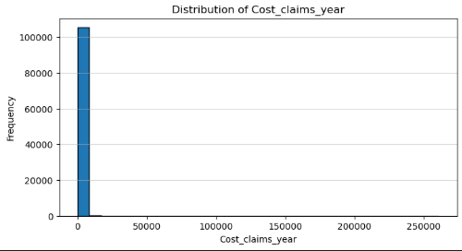
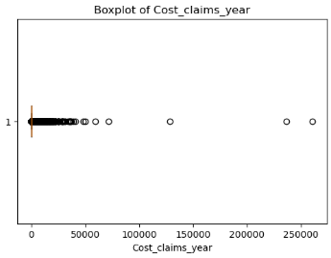
Cost of claims per year
Right-skewed distribution Low frequency, high severity Tail risk drives total loss ratio

Slide 7
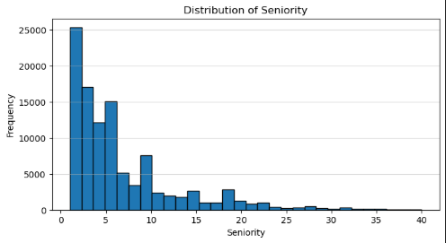
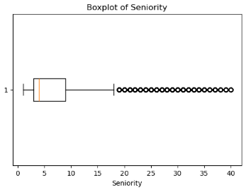
Seniority (years)
Right-skewed distribution Low frequency, high severity Tail risk drives total loss ratio

Slide 8
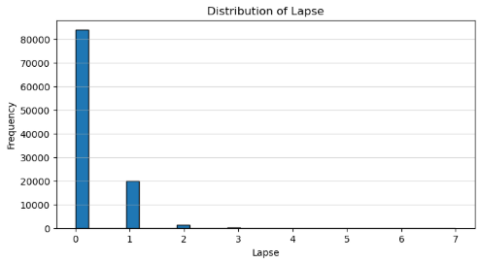
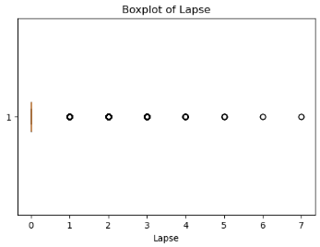
Lapse (Count of Cancelled Policies)
Stable retention Efficient renewal process Growth driven by new sales

Slide 9
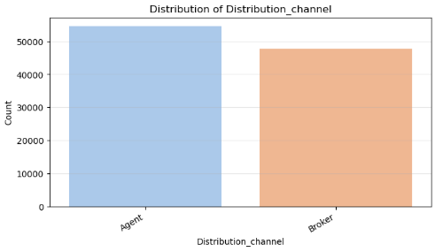
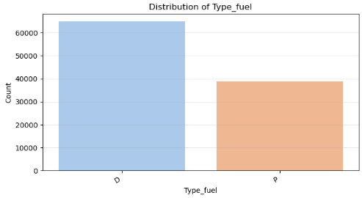
categorical
Distribution Channel vs Premium
Agents: relationship-based sales Brokers: larger, more complex clients Key difference in customer type and behavior
Diesel = older, high-mileage vehicles Petrol = newer and smaller cars Impacts claim frequency & pricing

Slide 10
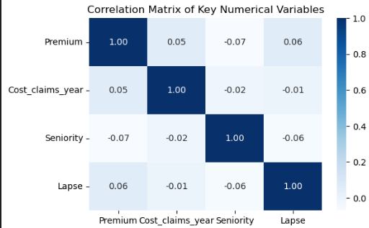
Bivariate EDA Numerical ↔ Numerical Relationships

Slide 11
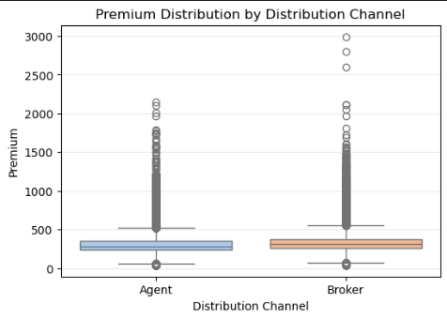
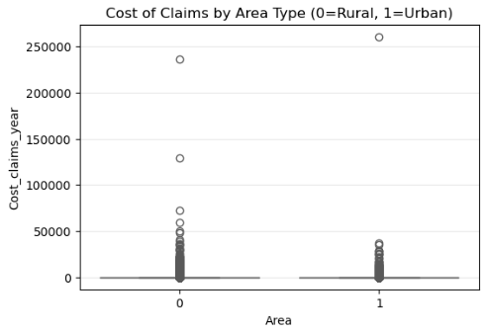
Categorical ↔ Numerical Relationships

Slide 12
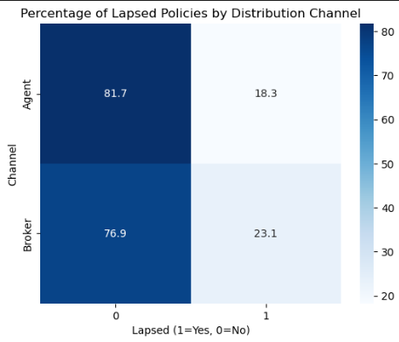
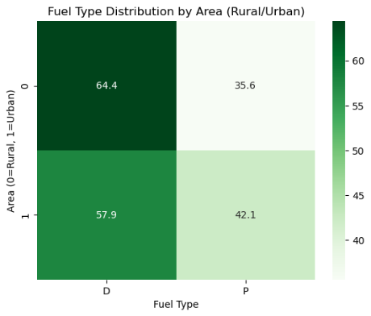
Categorical ↔ Categorical Relationships

